Slide 1
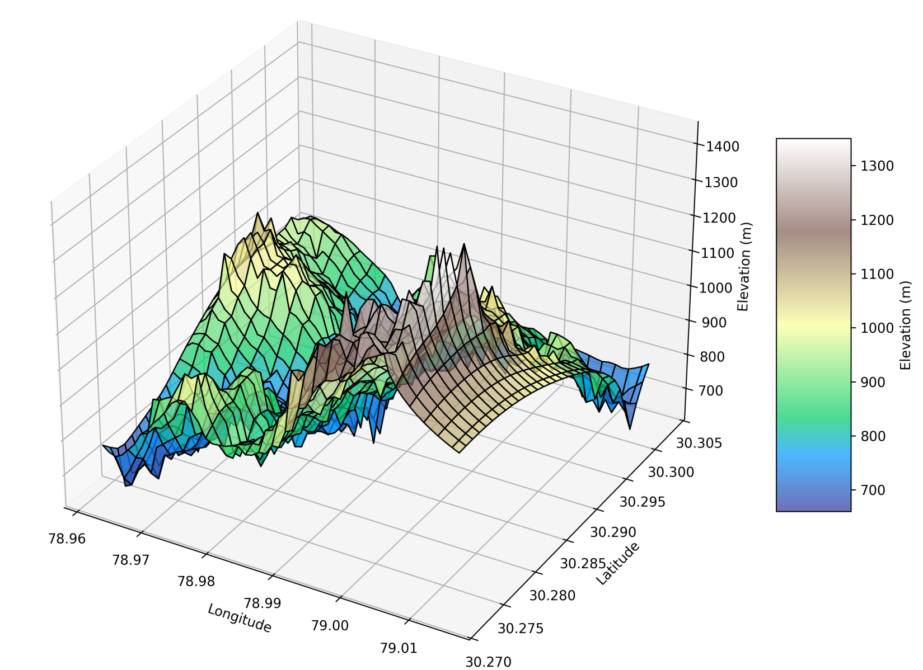
Visualizing Terrain with Python: Creating Digital Elevation Models from Google Earth Coordinates
Mandakini River
Alaknanda River
Rudraprayag
Alaknanda River
Subham Roy

Slide 2

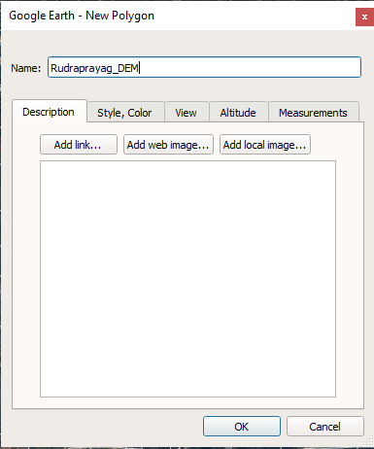
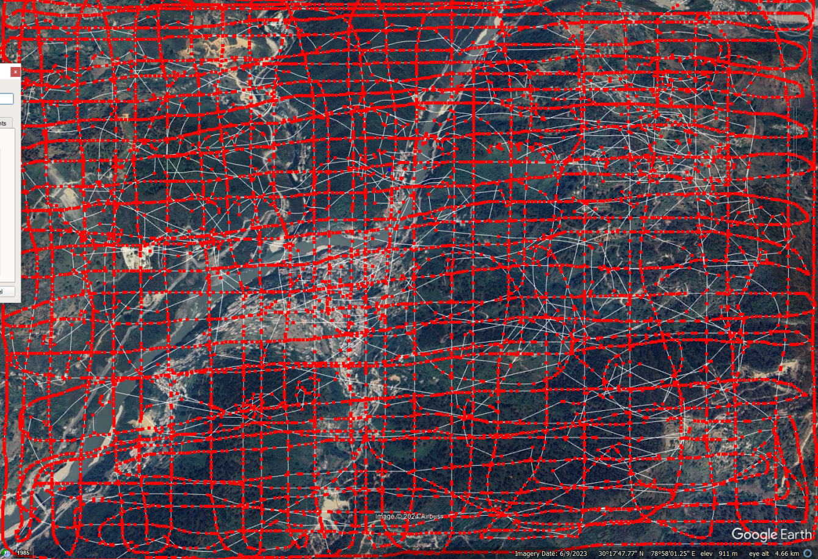
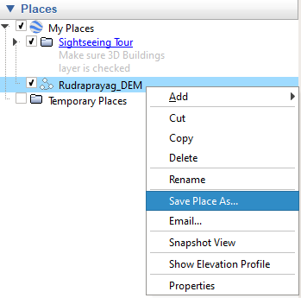
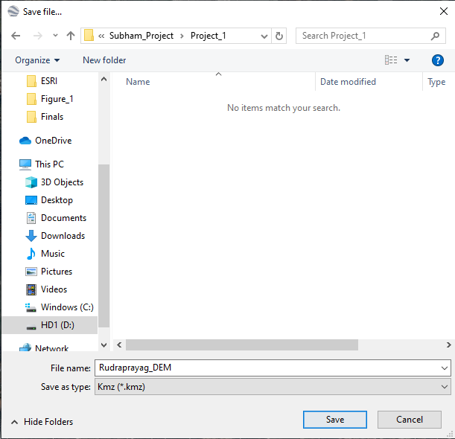
Steps:
Open Google Earth.
Click on the "Add Path" option. A new window will appear. In the window, enter a name((e.g., Rudraprayag_DEM) in the "Name" field.
Use the left mouse button to click and hold on the overview map. Draw a line by tracing the area where you want to collect points for creating the DEM.
Once you have collected the points, click "OK" in the Add Path window.
You will see this file in the 3D Viewer panel with the name you provided.
Select the file, then right-click on it. A window will appear. From that window, select the "Save Place As" option and click on it. Choose the location on your local system where you want to save the file, and ensure the file type is set to .kmz.
Instruction box
Subham Roy

Slide 3
https://github.com/Roysubh/Visualizing-Terrain-with-Python-Creating-Digital-Elevation-Models-from-Google-Earth-Coordinates/blob/main/Code.ipynb
download the code from the following GitHub link and upload it to your Jupyter Notebook environment.
Once the code is uploaded, kindly proceed with the further steps as described in the script.

